Slide 1
Treasury Toolbox
All you need to know as a non-treasury club member

Slide 2
Treasury Activities & Timeline
When & how to involve treasury in event planning
Develop Event Idea
Request Finance Code
Engage with Sponsors
Pay Suppliers
Request Reimbursement
£⁺
Host
Event
Timing
Document idea 8 months to 3 weeks before event date | Request as soon as event is approved but at least 2 weeks before event | Draft contracts at least 3 weeks before event (finance code required) | Obtain invoice at least 3 weeks before event (finance code required) | Submit expense receipts within 2 weeks of event
Internal club’s documents or drive, timing, codes, approvals, etc. | Finance Code Request Form | Sponsorship Template Contract & Info Form | Supplier Payment Guidelines & Info Form | Reimbursement Request Form; Set-up directions
Tools

Slide 3
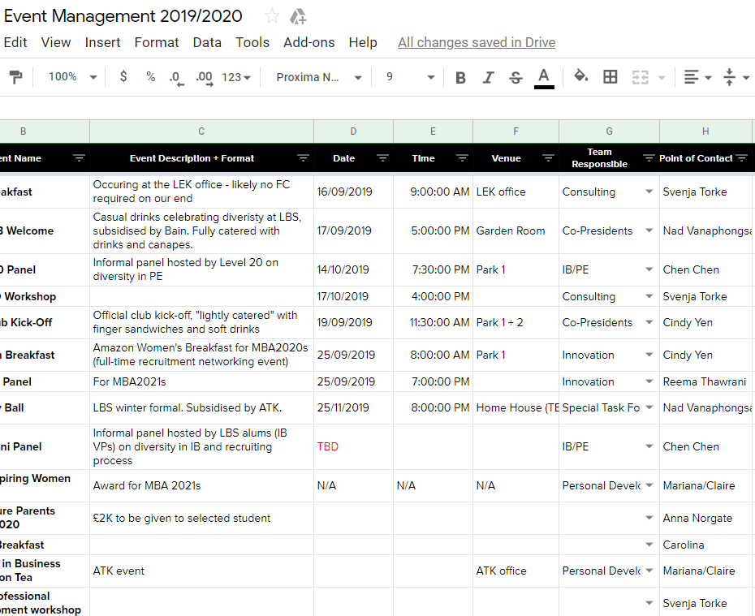
DEVELOP EVENT IDEA
Event Owner’s Action Items
Why it’s Important
Documenting these events will help Treasury team stay ahead of deadlines and better support your team.
# | Action | Owner | Timing
0 | Gain approval for event from Presidents; copy Treasurer for background information | Event team | At least 3 weeks before event (earlier the better)
1 | Document event in your internal GoogleDoc listing estimated revenue, costs, date, and anticipated sponsorship monies | Event team | At least 3 weeks before event
2 | Notify Treasurer of line item addition via email | Event team | Upon posting to GoogleDoc
Tips
Setup a GoogleDoc where you manage a list of your events and events / finance codes
Set a plan for your team per term to increase visibility and proactivity. Outline the events you hope to host for the term and gain approval early.
Add events before they’re finalized – it’s okay to change details later! Most important part is getting the possible event on the radar
Outline expected costs so reimbursement is approved later
Suggested tool for Club
Internal Event Management GoogleDoc
(insert link before sharing)
Fill in each column

Slide 4
REQUEST FINANCE CODE
Event Owner’s Action Items
Why it’s Important
A finance code is unique to each event hosted by a club – internal and external). It is used to tag money, both incoming and outgoing, to the club. For example, it’s used by:
CampusGroups to make sure the ticket sales come back to the club and track RSVP numbers
Teams to request internal catering
Sponsorship forms – without a finance code, the money just goes to the SA
Individuals requesting reimbursement
# | Action | Owner | Timing
1 | Fill in Finance Code Request Form with event’s details | Event team | At least 2 weeks before event (earlier the better)
2 | Email form to Treasury | Event team | At least 2 weeks before event
3 | Apply for Finance Code from SA | Treasury | Approval takes one week
4 | Notify event team of approval and add finance code to GoogleDoc, if there is one | Treasury | Upon approval
5 | Apply Finance Code to CampusGroup event page and catering requests (etc.) | Event team | Upon notification
Tips
Finance codes, once approved, can be referenced at anytime on the club Event Management GoogleDoc
Tool
Finance Code Request Form (email)
Double click for form

Slide 5
ENGAGE WITH SPONSORS
£
Event Owner’s Action Items
Why it’s Important
Approval process takes three weeks given the number of parties involved. Treasury should be informed and looped in early to make sure we get the funds in time!
# | Action | Owner | Timing
1 | Draft contract and send to Sponsor for review and edit requests | Sponsor team | More than 3 weeks before event
2 | Send contract to SA Sponsorship team for signature; copy Treasury | Sponsor team | More than 3 weeks before event
3 | SA reviews, approves, signs, and sends back contract | SA | More than 3 weeks before event
4 | Send approved contract back to sponsor for final signature; copy Treasury | Sponsor team | More than 3 weeks before event
5 | Send Sponsor Information via email form to Treasury | Sponsor team | 3 weeks before event
6 | Treasury raises invoice to sponsor using contract + info from team | Treasury | 3 weeks before event
Tips
Update bullets under section 9 of the contract based on what you’ve promised the sponsor – these will likely change for each contract and are very important!
Sponsor will pay 20% VAT on top of their contribution
SA Sponsorship Team is Ed Boyanoski and Veer Jhamtani
eboyanoski.mba2021@london.edu
vjhamtani.mba2022@london.edu
Contracts should only address a single event, in case of sponsoring multiple events you should draft multiple contracts
Tools
1. SA’s Sponsorship Guide (link) for more details
2. Sponsor template 2020
3. Sponsor information
Double click each icon for form

Slide 6
PAY SUPPLIERS
Event Owner’s Action Items
Why it’s Important
Paying a supplier takes time but typically is critical to an event’s success (e.g., venue, food, drinks, trek hotel!!). Get these in early!
# | Action | Owner | Timing
1 | Obtain an invoice from supplier addressed to: London Business School Student Association, attn.: [CLUB] Sussex Place NW1 4SA London, UK | Event team | At least 3 weeks before event
2 | Send Treasury supplier information and attach invoice | Event team | At least 3 weeks before event
3 | Treasury submits invoice to SA Finance | Treasury | At least 3 weeks before event
4 | SA Finance approves and sends to LBS Finance | SA Finance | 1 week later
5 | LBS Finance approves and send funds to the supplier | LBS Finance | 1 week later
Tips
SA Finance and LBS Finance conduct their activities in batches on Fridays, so it takes two weeks to get through their queue
We have limited visibility into process once invoice is submitted to SA
Tool
Supplier information (email)
Double click for form

Slide 7
REQUEST REIMBURSEMENT
Event Owner’s Action Items
Why it’s Important
Club is responsible for funds spent and students are reimbursed.
# | Action | Owner | Timing
Applies to club expenses that were paid on personal card. This should be reserved for things that cannot be paid for in advance through a supplier or pre-payment from the club directly
0 | Save your receipts! Keep track of your spending | Event team | As you go
0 | Register yourself in the Reimbursement System as you begin spending. It takes two weeks to be approved by LBS Finance | Event team | At least 2 weeks before submitting reimbursement request
1 | Submit Reimbursement Request to Treasury team. Rename attachments so we know which receipts correspond to charges | Event team | Within 2 weeks of event (you can submit expenses as you go, too)
2 | Treasury submits reimbursement info to SA Finance | Treasury | Within 3 business days of receipt
3 | SA Finance approves, LBA Finance sends reimbursement funds | SA, LBS Finance | 1-2 weeks later
Tips
PLAN AHEAD! Use the club’s funds for prepayment by requesting a supplier payment 3 weeks before the event (see SUPPLIER slide)
Request reimbursement within two weeks of the conclusion of an event to ensure repayment
Tool
1. Reimbursement system registration (link)
2. Reimbursement Request Form (email)
Double click for form

