Slide 1
Siem Reap – Bangkok – Ayutthaya – Koh Samui
28th March – 5th April 2015

Slide 2
Overview
28 - 30 March
31 March
1– 2 April
3 – 5 April
Siem Reap
Ayutthaya
Bangkok
Koh Samui

Slide 3
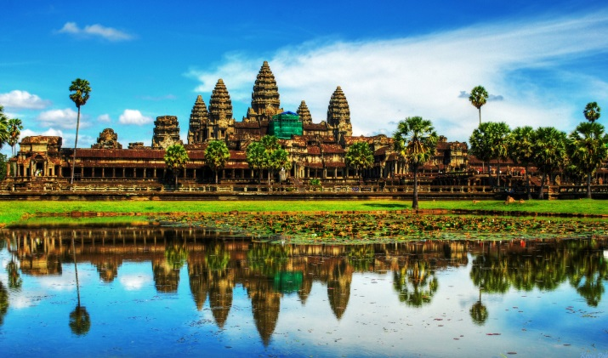
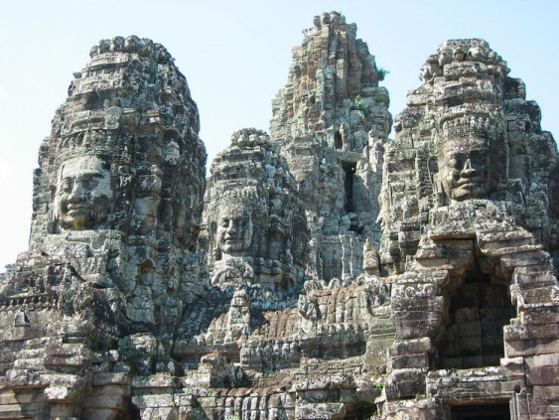
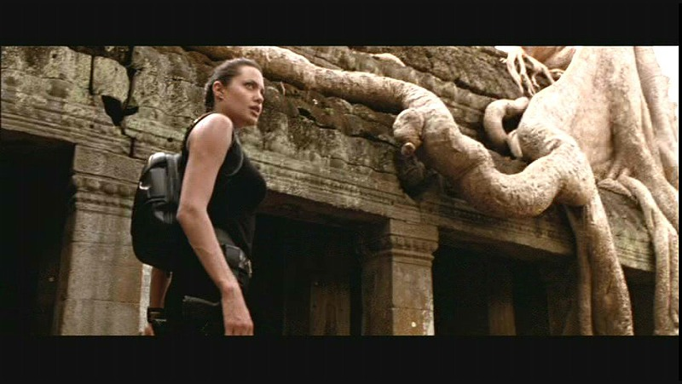
Siem Reap: 28th -30th March
Bayon Temple of Ankor Thom
Ankor Wat
Ta Prohm
UNESCO World Heritage site
The biggest religious monument in the world
Ankor Thom was the world’s largest city in 12th century
Visit the temple with 37 towers and 2000 stone faces
Visit Lara Croft: Tomb Raider filming site
See the reptile-like trees that grow all over the temple

Slide 4
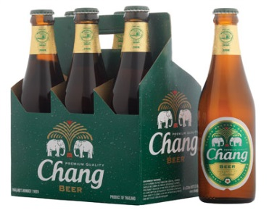
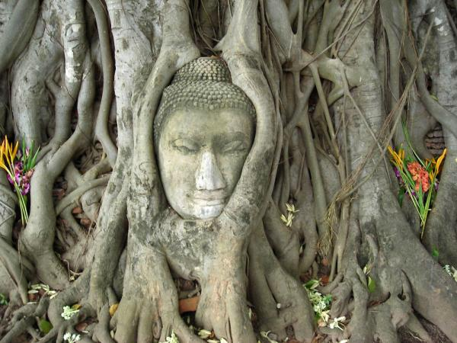
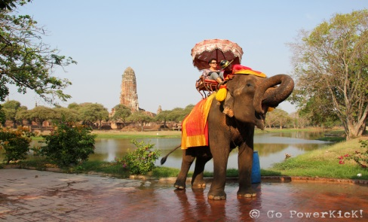
Ayutthaya: 31st March
The largest beverage manufacturer of Thailand
Chang is also the Everton football club owner
See the Buddha sculpture that is buried inside the tree
Visit the relics of Lord Buddha
Chang Beer
Factory
Wat Mahatat
Ride the elephants along the temple ruins of the old capital city
Buy local snacks, toys and souvenirs from the boats vendors
Elephant Ride
Floating Market

Slide 5
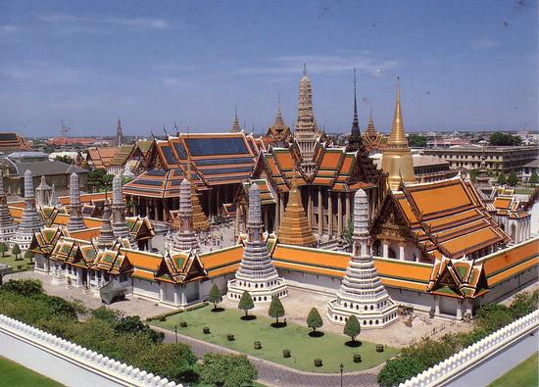
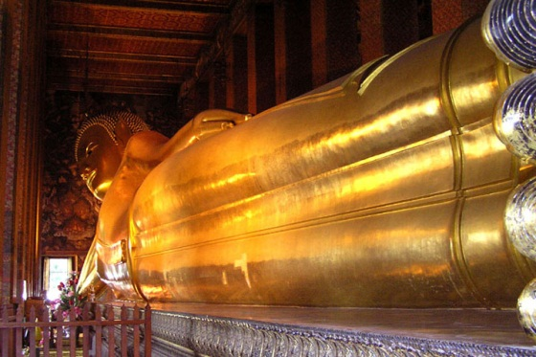
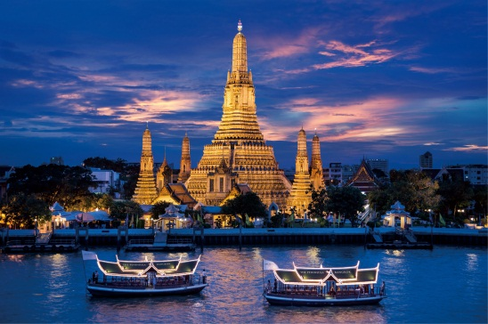
Bangkok: 1st April
Visit the previous residence of the Kings in Thailand
Pay respect to the Emerald Buddha
See the 46m Reclining Buddha golden sculpture
Visit the most traditional massage school
The Grand Palace
Wat Po
Explore the Bangkok nightlife and taste the famous bucket drinks
Experience the street vendors including fried insects food stalls!
Appreciate the beauty of the colorful pagoda made of porcelain by the Chaophraya River
Temple of Dawn
Khao San Road

Slide 6
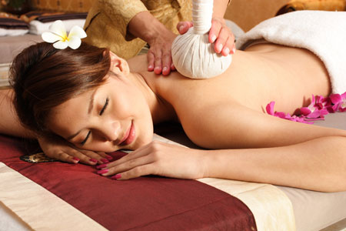
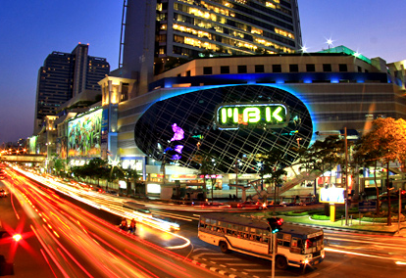
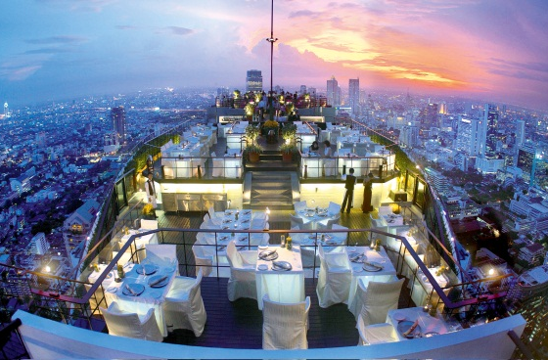
Bangkok: 2nd April [Free Day]
Watch a real Muay Thai fight
OR become a boxer yourself and take a Muay Thai class!
Get a relaxing Thai body or foot massage
Muay Thai
Thai Massage
Shop til you drop at the wholesale market or countless discount malls
Chill out at a rooftop bar and appreciate the Bangkok skyline lights at night
Shopping
Sky Bar

Slide 7
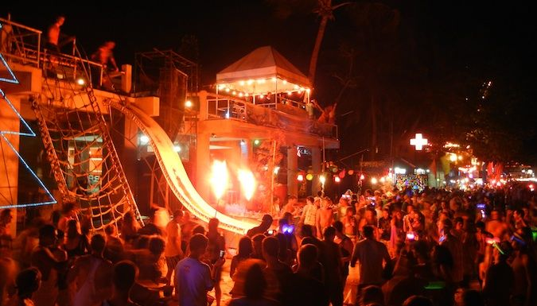
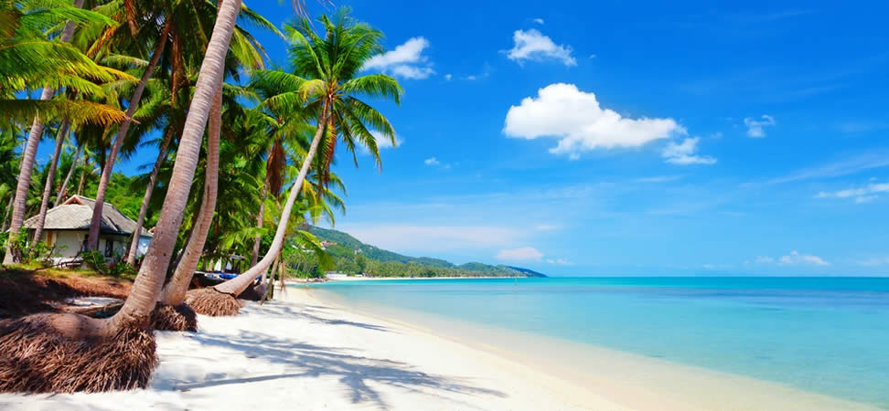
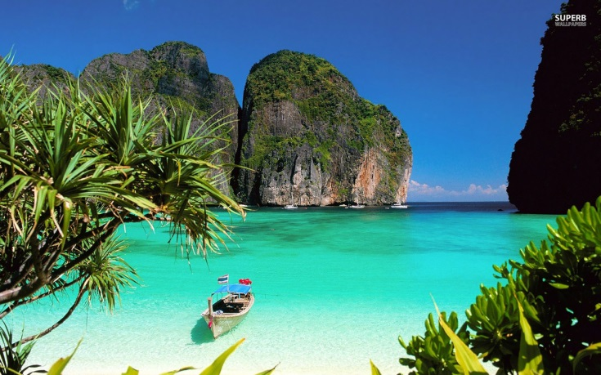
Samui: 3rd – 5th April
Fullmoon Party
The Beach
Koh Tao and Koh Nangyuan (Optional)
The largest, most renowned island-wide beach party
“the best spirit of partying I've ever seen, this is a once in a lifetime experience....”
Relax by the beach: get tanned, play water sports or get a beach massage
Snorkel and enjoy the “paradise on earth” islands

Slide 8
Key dates
Date | Flight | Detail/imp info | Hotel
28 Mar 2015 | Bangkok Airways PG 907: 17.40 | Depart BKK for Siem Reap Meet at Suvarnabhumi Airport (int’l airport) | 3* hotel in Siem Reap (Single add GPB 40)
29 Mar 2015 |  | Preah Khan-Neak Poan- Sunset at Pre-Rup | 3* hotel in Siem Reap
30 Mar 2015 | Bangkok Airways PG 910: 21.30 | Angkor Thom, Taphrohm, Angkor Wat Depart Siem Reap for BKK | 4* hotel in Bangkok
31 Mar 2015 |  | Ayutthaya- Old Capital of Thailand –Chang Beer factory | 4* hotel in Bangkok
1 April 2015 |  | Bangkok Tour –Grand Palace-Khao San Road | 4* hotel in Bangkok
2 April 2015 |  | Bangkok Free day –Massage – Shopping | 4* hotel in Bangkok
3 April 2015 | Bangkok Airways PG 109: 7.25 | Depart BKK for Koh Samui Full moon party | 3* hotel in Samui
4 April 2016 |  | Samui Free day-optional island tour | 3* hotel in Samui
5 April 2016 | Bangkok Airways PG 118: 9.20 | Arrive BKK and fly back to the UK!! | 3* hotel in Samui

Slide 9
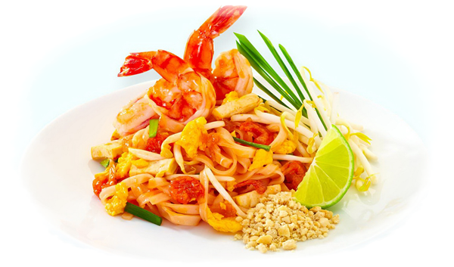
Why South East Asia Trek?
Cultural Visit
Party
Food!
RELAX!!

Slide 10
How to reserve a spot
When: Booking opens NOW – 18 January
Where: https://clubs.london.edu/AsiaClub/rsvp?id=22825
How much:
Deposit £450
The rest of the fee £400
Questions? Please contact:
Khemploy - khemployt.mba2016@London.edu
Kade -kwilailak.mim2015@London.edu

Slide 11
The price does not include:
VISA to Thailand Double Entry £50 (most of you don’t need it)
VISA to Cambodia (USD 37)
One free day in Bangkok (Lunch/Dinner/Thai Massage/transportation)
One free day in Samui
Optional Koh Tao, Koh Nang Yuan approx. £42

Slide 12
Hurry! The spaces are limited!
Booking ends on 18th January 2015

Slide 13
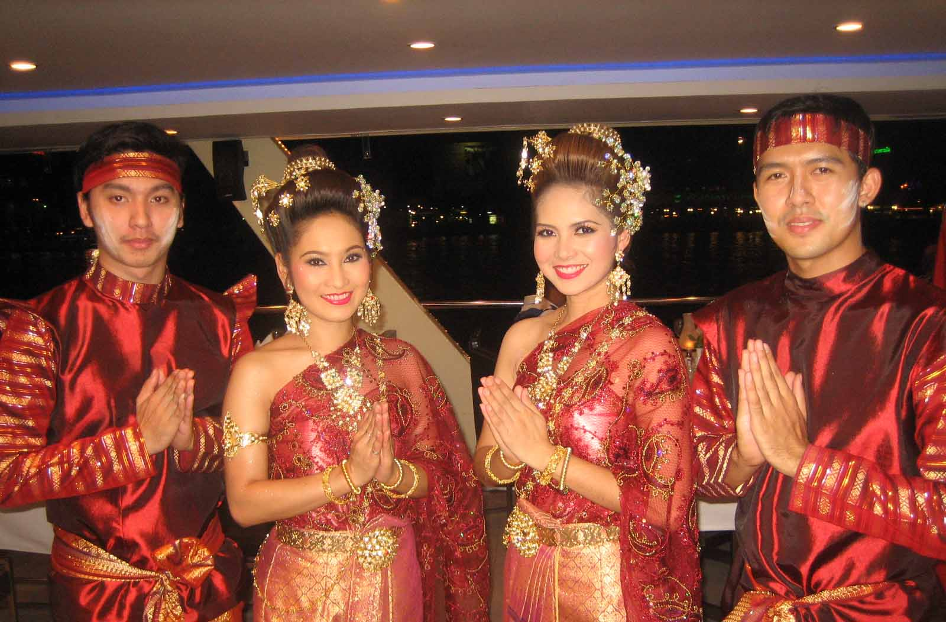
Hope to see you at our trek!!!

Slide 14
VISA to Cambodia
Can be applied online: https://www.evisa.gov.kh/
Cost USD 37
Requirement:
Passport valid more than 6 months
Recent passport-size photo in digital format (JPEG or PNG format)
Valid credit card (Visa/MasterCard)
Processing time 3 business days
VISA will be sent to you via email: PRINT IT OUT AND BRING IT WITH YOU TO CAMBODIA

