Slide 1
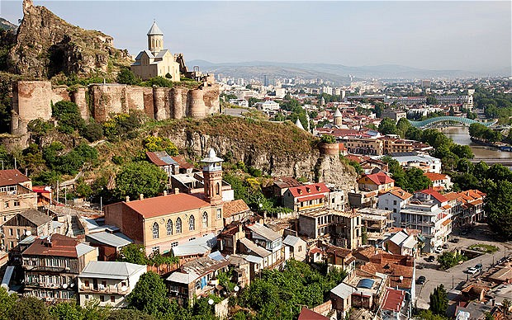
Georgia Trek May 12-15

Slide 2
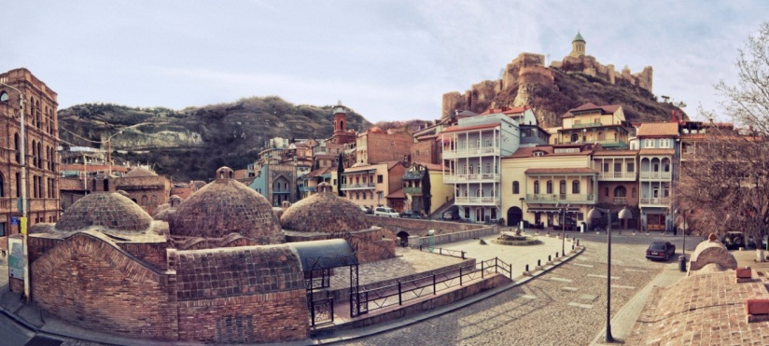
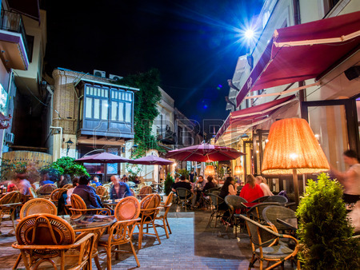
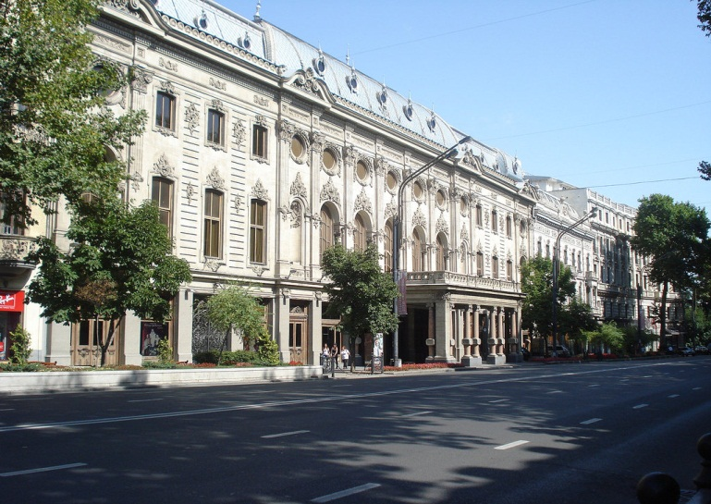
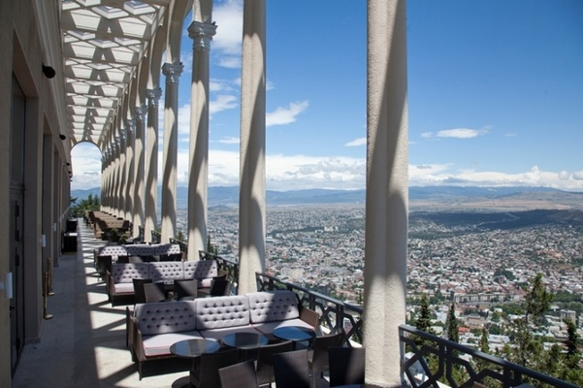
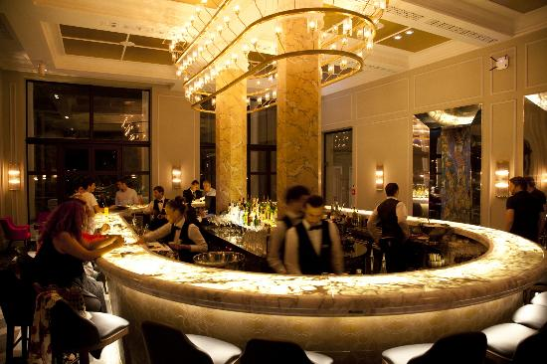
Day 1 – 12 May
Tbilisi
Visit old part of the city
Lunch in funicular restaurant
Exploring new part of the city
Dinner and drinks (lots of wine ☺)

Slide 3
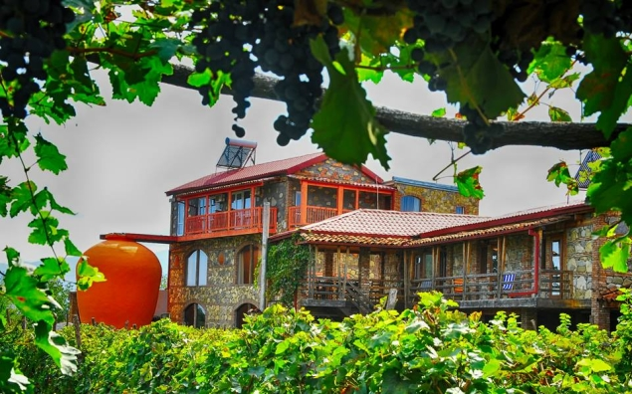
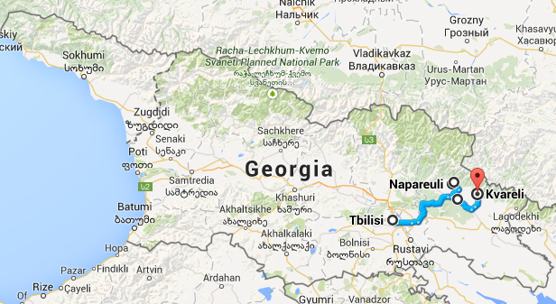
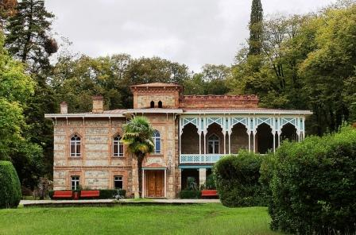
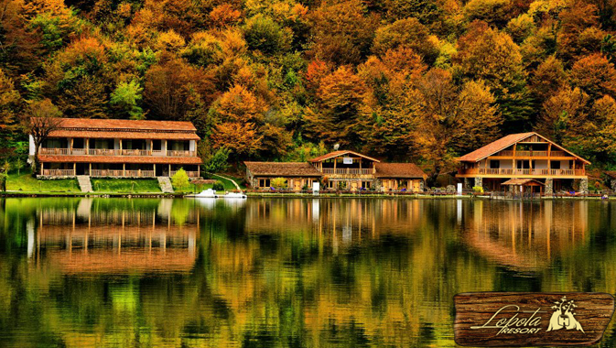
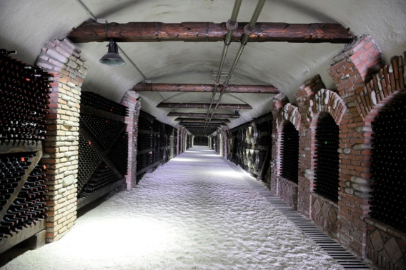
Day 2 – 13 May
Kakheti – wine tour
Visit traditional winery and observe over 8000 years old wine making method; wine tasting
Lunch at Lopota resort; local wine tasting
Visit Prince Chavchavadze palace; local wine tasting
Visit King Erekle`s palace; Dinner in “Shuamta” restaurant
Open bar at Bar El Centro ( I used to party here every weekend ☺ )

Slide 4
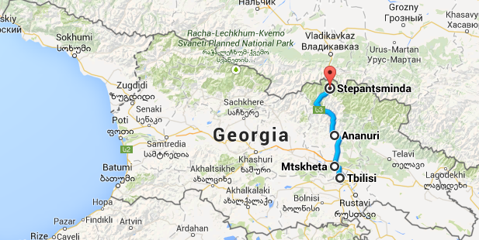
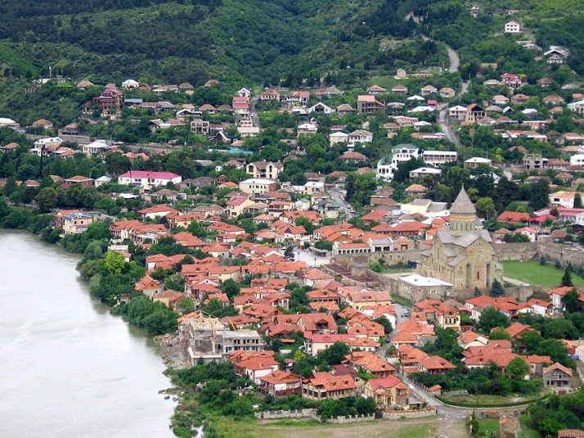
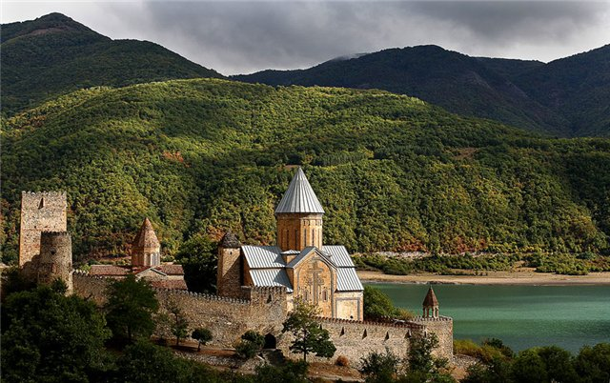
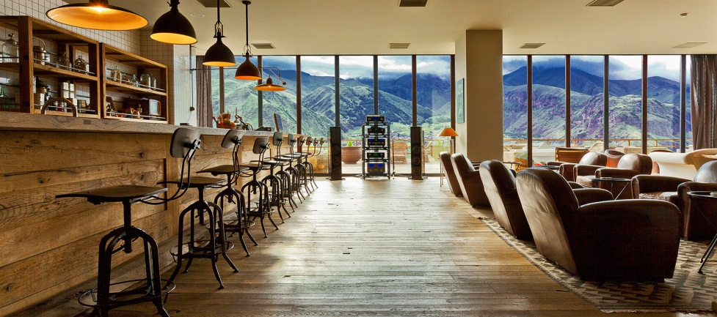
Day 3 – 14 May
Mtskheta, Ananuri
Visit ancient capital of Georgia -Mtskheta (3rd c. BC-5th c. AD)
Fortress Ananuri
Check-in at Rooms Hotel Kazbegi
Lunch
Free Time
Dinner
Lounge bar

Slide 5
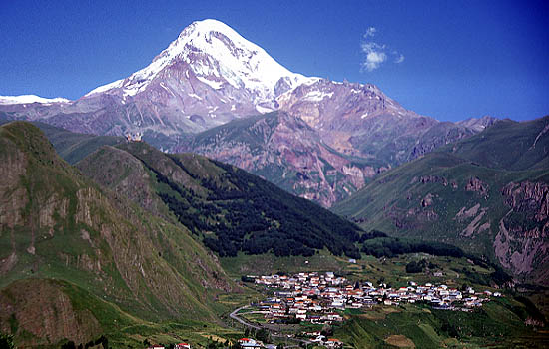
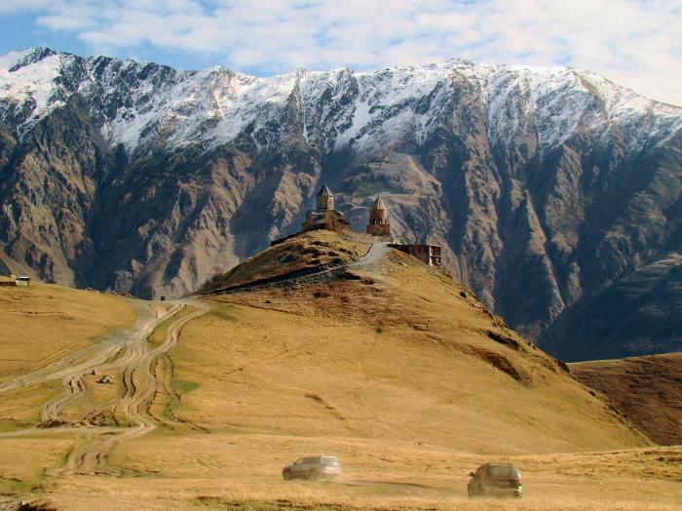
Day 4– 15 May
Kazbegi
Visit Gergeti Holy Trinity monastery
Check-out
Transfer to Tbilisi airport

Slide 6
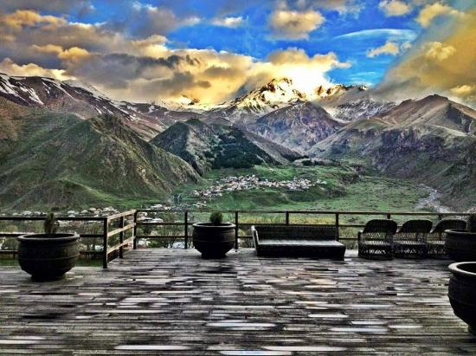
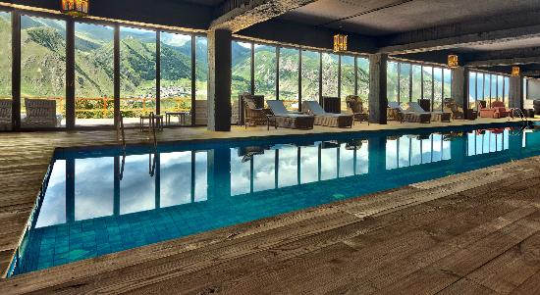
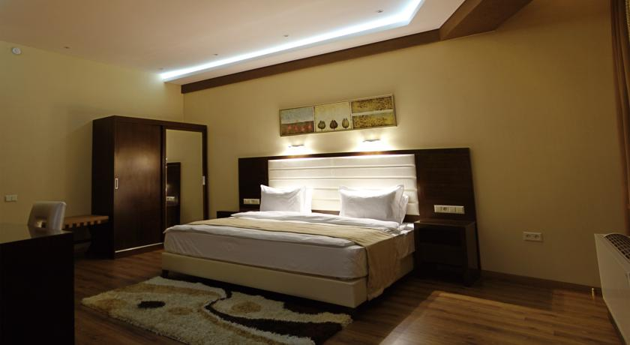
Hotels
Hotel Orioni 4*
Rooms Hotel Kazbegi 4*
Twin or double rooms
Breakfast
Free wifi
Located in city center
http://www.hotelorion.ge/
Twin or double rooms
Breakfast
Free wifi
24 hours bar
Swimming pool
Terrace with magnificent views
Paragliding, horse riding, quadrocycling at extra cost
http://roomshotels.com/kazbegi

Slide 7
Fees and registration
Cost of the trek £350
Includes:
Accommodation for 4 nights (including May 11th night)
Airport transfer
Transportation to Kakheti and Kazbegi
Lunches at Lopota Lake and Rooms Hotel Kazbegi
All dinners
All wine tastings
Open bar at bar El Centro
Does not include:
Flight tickets (around £250-350 connecting flights)
Lunch in Tbilisi
Extra activities at Rooms Hotel Kazbegi
How to register:
12 tickets for sale. Registration for the event opens on Monday, February 15 at NOON
After registering you will receive instructions for the payment (due on Friday February 19)
For further questions send an email to tnatroshvili.mba2017@london.edu

