Slide 1
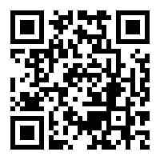
Exploring Careers in
People Professions
Join the People Strategy Society
if you have not!
People Strategy Society with Career Centre
7th October

Slide 2
Agenda and Meeting Policy
Agenda
Briefing on People Professions recruitment
Q&A on briefing
Panel Discussion
Q&A with Panellists
Meeting Policy
Only briefing is recorded and the slides and video will be shared after the event
Chatham house rule applies to the panel discussion
(WHAT is discussed in the meeting can be shared with those who did not attend it but WHO said that must not be disclosed)
You can ask questions anytime using the chat or raise hand function
Please turn on your camera if you can!

Slide 3
Briefing on
People Professions recruitment

Slide 4
What are People Professions?
People Professions refer to roles to enhance people and organisational performance in business
Corporate
Professional Services
1
2
Consulting Firms
Human Resources
(=People Operations in
Tech firms)
3
Executive Searches
& Coaching Firms
…
L&D services,
Career coaching, e.t.c.
We will talk about (1)HR, (2)Consulting firms and (3)Coaching companies today

Slide 5
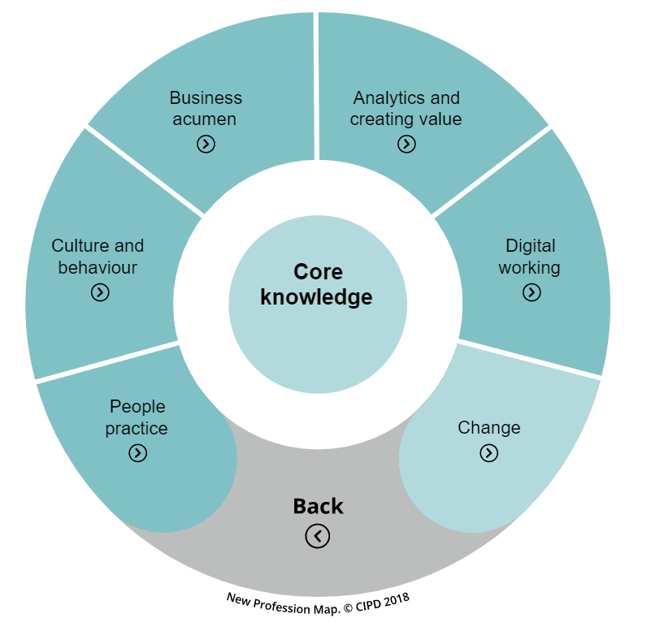
Why People Professions after LBS?
a
Trends in People Professions
The roles are shifting from operational to strategic
  Administrative roles are now being concentrated to particular sectors, allowing HR to focus more on strategic roles
  Alignment between HR and company’s strategic direction is becoming ever more important
As a result, people departments need talent with business acumen and analytical skills
Getting people and culture right is the most important business issue
“Culture eats strategy for breakfast” by Peter Drucker

Slide 6
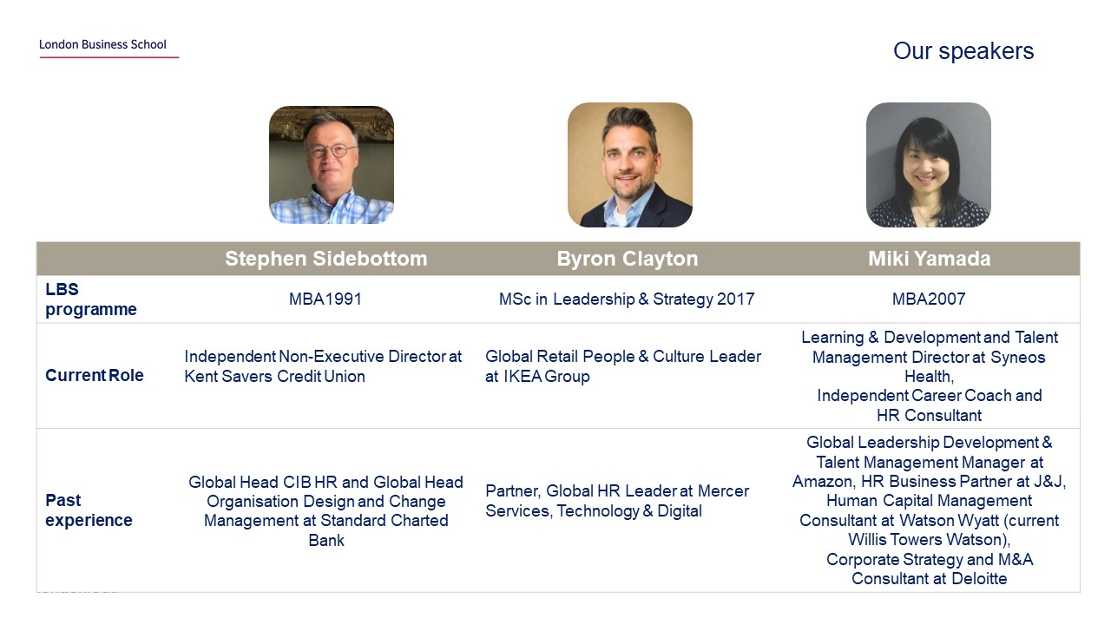

LBS Alums in People Professions
There are many LBS alums who’ve built successful careers in the field
We’ve invited them to our event last year!

Slide 7
What is HR
1
Corporate HR
HR is one of the largest areas in People Professions and requires business knowledge as well
Example of HR department structure
Centre of Excellence/
Operational Excellence/
HR Services
HR Business Partner/
Business Unit HR
Specialised HR
Focuses on administrative roles such as payroll, taxes, welfare etc
Supports business functions at all levels including daily issues to organisational restructuring
Focuses on certain areas such as hiring, employee relations etc
Business school graduates tend to work in this area

Slide 8




Recruiting for HR
1
Corporate HR
Some companies run structured recruiting for HR or related roles
But most of recruiting in HR is unstructured
Some corporates provide HR rotational programmes
Resources to find structured recruiting opportunities
List created by the People Strategy Society
https://docs.google.com/spreadsheets/d/1BAAEGu5vluxDASBYMRbMFTCGmSVtqP_VJJ0PhdVesos/edit?usp=sharing
MBA Exchange
https://www.mba-exchange.com/
Worldwide
US&UK
Tips for unstructured recruiting
For internships, start-ups tend to be more flexible than large corporates
Attend “Tech & Startup Networking Evening” by Career Centre (February), get information through Tech & Media Club, Campus Community and look through Job Boards specialised for start-ups;
  www.otta.com
  www.angel.com
  www.workinstartups.com
EMEA
More options in the US and for early careers

Slide 9
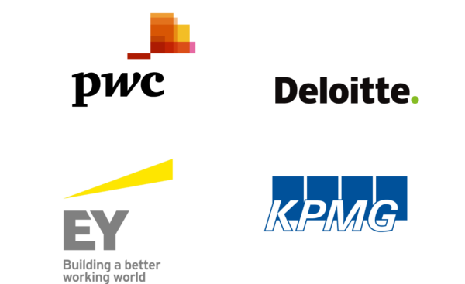




Recruiting for Consulting Firms
2
Consulting
Strategy consulting firms have areas focused on Organisation
Or to specialise further, choose HR Consulting firms
Strategy Consulting (structured hiring)
Specialised HR Consulting (unstructured hiring)
Most strategy consulting firms have “Organisation” as a functional axis
Projects vary by firms and offices so do your research
Strategy firms generally hire students as a generalist except for:
Accenture hires mid-careers as a functional or industrial specialist, including Talent & Organisation (T&O)
McKinsey’s some offices hire Implementation Consultants (includes Change Management and Organisational Transformation)
Specialised HR Consulting firms include:
Human Capital sections of Big4
HR firms such as Mercer, Willis Tower Watson
Mostly unstructured hiring and look for relevant experiences (US offices offer more opportunities: follow their career pages, Mercer Japan has MBA structured recruiting)
Other Small boutique firms
Attend “Boutique Consulting Careers Fair” by Career Centre (March)

Slide 10

Recruiting for Executive Search & Coaching Firms
3
Executive Search
& Coaching
Executive Search firms and coaching companies provide leadership development and consulting to executives
Executive Search Firms
Specialised Coaching Companies
Executive search firms include Egon Zehnder, Korn Ferry, Russel Reynolds etc
They have three main functions, search, coaching and assessment to support the leadership development of executives and to build the best management team for the company
Their competitive advantage is the network they have in the market
There are some firms that focus only on coaching without the search and assessment functions
Their competitive advantage is the coaching skill they have developed
Search
Coaching
Assessment
Recruiting is mostly done through networking – There are some LBS alums working in the area!

Slide 11
Advise: Network, network, network
Networking is super important for both structured and unstructured recruiting
Leverage LBS network
Talk to today’s panellists, or your classmates who have experiences in the field
LBS Faculties
Alumni
  LBS Hub: https://www.lbshub.london.edu/
  LinkedIn
Leverage Career Centre resources
“Build Connections” series
“Leverage Connections for Career Impact”
Talk to career coaches

Slide 12
Advise: Familiarise yourself with terms and trends
You should be able to talk about..
Useful resources
CIPD
https://www.cipd.co.uk/
McKinsey Organization Blog
https://www.mckinsey.com/business-functions/organization/our-insights/the-organization-blog
Human Resource Executive
https://hrexecutive.com/
Work from home
People Analytics
Employee Experience
Diversity & Inclusion (D&I)
Employee Wellbeing

Slide 13
Q&A on briefing

Slide 14
Panel Discussion

Slide 15


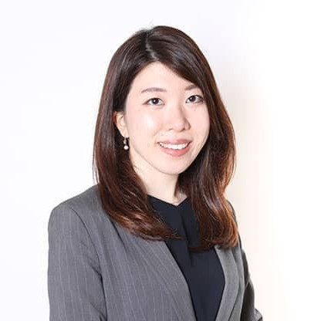
Our speakers
 | Michelle Cheng Harker | Alex Roussel | Yurika Takahashi
LBS programme | MBA2021 | MBA2020 | MBA2021
Post-LBS Career | - | Global People Manager at AB InBev | -
Summer Intern | Manager – Colleague Experience Group at American Express | People Strategy & Operations at IMMO Investment Technologies | Consultant at Egon Zehnder, Human Resources Team at Amazon
Pre-LBS Career | Strategy and Innovation Manager, Global Corporate Citizenship at Accenture | Client Advisor at Rothschild, Relationship Manager at HSBC | Consultant at Kearney

Slide 16
Q&A with Panellists

