Slide 1

People Strategy Society
Kickoff 2020

Slide 2
What is People Strategy Society?

Slide 3

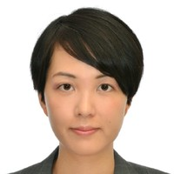
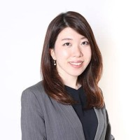
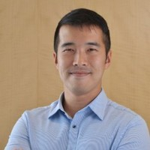
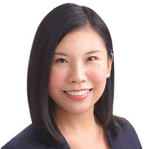
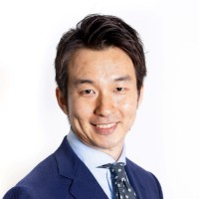
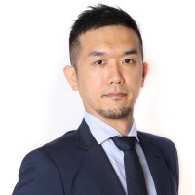
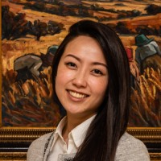
Who we are
We are a brand-new student group established in August 2019
With around 190 members from different courses (as of September 2020)
Currently at a “Society” status (probation of a Club), aiming to become a Club next February!
Madoka Furuhashi
Co-founder/Co-President
MBA2021
Yurika Takahashi
Co-founder/Co-President
MBA2021
Andrew Yeo
ExCo
MiF2021 (part-time)
Megumi Jiang
ExCo
MBA2021
Ryosuke Hiraide
ExCo
MBA2021
Ryota Sakeshima
ExCo
MBA2021
Shirley Wu
ExCo
MBA2021

Slide 4
Our objectives
We target both aspiring general managers and aspiring people professionals
We have two main objectives:
Engage students in the area of People Strategy to support their success as business leaders across industries
  People Strategy is defined as means to leverage people and organisations to execute business successfully (including HR and a part of OB)
Develop students’ careers in the area related to People Strategy/Human Resources, including Employee Engagement, Talent Management, Learning & Development, and Coaching by:
  Supporting students to develop the necessary skills and networks
  Promoting the value of business schools learnings to the wider HR community

Slide 5
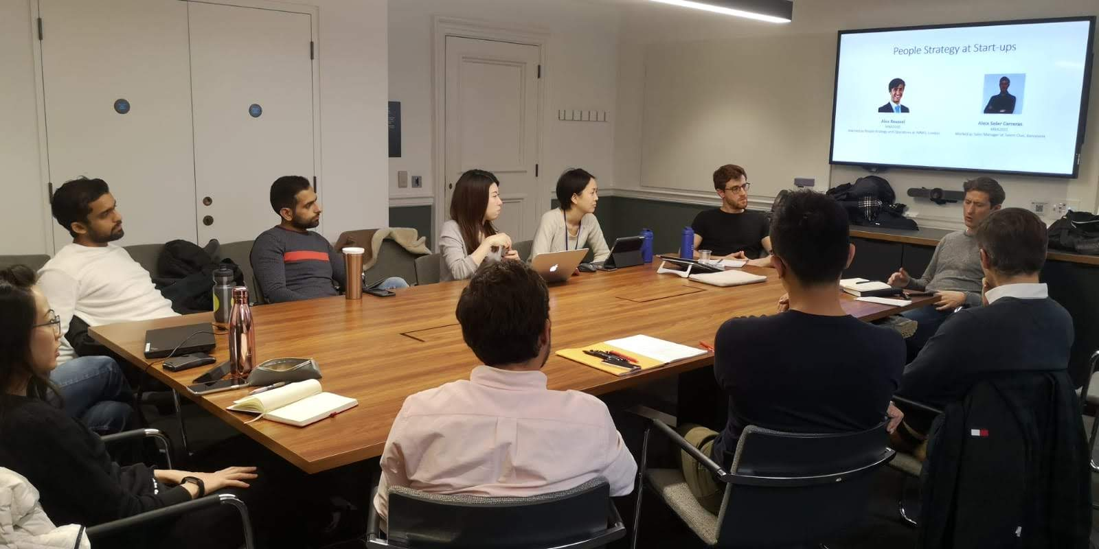
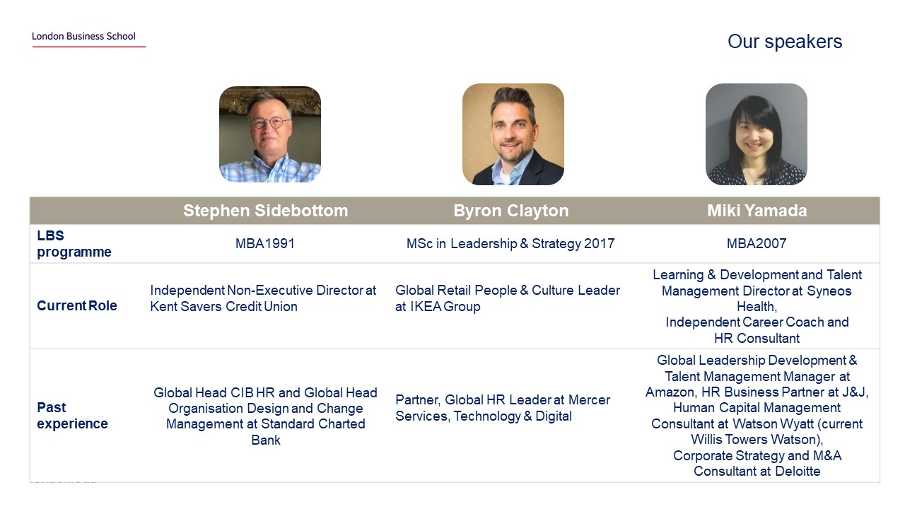
Our activities in 2019-2020
August, 2019
WhatsApp group Created
Events
February, 2020
Approved by the Student Association as a Society
November, 2019
“People Strategies at Startups”
May, 2020
“LBS alumni in People Professions”

Slide 6




2020-2021 Activities Schedule
Autumn term, 2020
Panel on D&I with Dr. Aneeta Rattan and guest speakers
Exploring careers in HR/People Professions
Coaching practice sessions
Spring / Summer Term, 2021
Presentation to SA to become a club (Feb)
Panel on self-managing organisations with Prof. Julian Birkinshaw and guest speakers
LBS Alumni in People Professions 2021
Would love to discuss more idea with new ExCo!

Slide 7
2020-2021 ExCo Recruiting

Slide 8
Reinventing the Club Management Practices
To achieve higher engagement, our ExCo team operates very differently from other clubs
Applying what we know about “People Strategies” theories and best practices
Staying as flexible as possible and avoiding bureaucratism
Enhancing each member’s “intrinsic motivation”
We will continue experimenting and improving the model thought the year
Your suggestions are always welcome!

Slide 9
Project-based Assignment
No fixed roles, tasks are assigned on a project-basis (Intrinsic motivation: “Do what you are interested in”)
No set number of open positions (target 6-10)
All ExCo can join any projects that they are interested in, or propose and initiate their own project
You can get involved in multiple projects at the same time
ExCo meetings are held bi-weekly
Titles can be crafted based on your contribution E.g. People Strategy Society Exco – D&I event lead
Project lead proposes a new project
(at ExCo meeting or WhatsApp)
Project lead recruits other project members
Team works on the project
Update progress at ExCo meeting

Slide 10
Recruiting and Screening Process
New ExCo will be given tentative offers, which are to be confirmed in December
21-30 Sep
1-9 Oct
12 Oct
Oct-Nov
Dec
Application
Screening (interview)
Tentative decisions
Tentative ExCo
Confirmation
Commitment Expectation
Participate at least one project per term (around 3h/week)
Notify when not attending an ExCo meeting
Respond to whatsapp messages / fill in Doodle when requested

Slide 11
How to apply
Application
Fill in Google Form : https://forms.gle/ZzmeDj9UXtf6eJdS6
Why are you interested in People Strategy?
What do you want to do as an ExCo of People Strategy Society?
Screening
Application + Interview
Screening criteria
Passion for People Strategies
Alignment of candidate’s goal with our goal
Requirements
Any students who can commit at least until March 2021, ideally until June 2021 (2nd-year students are also welcome)

Slide 12

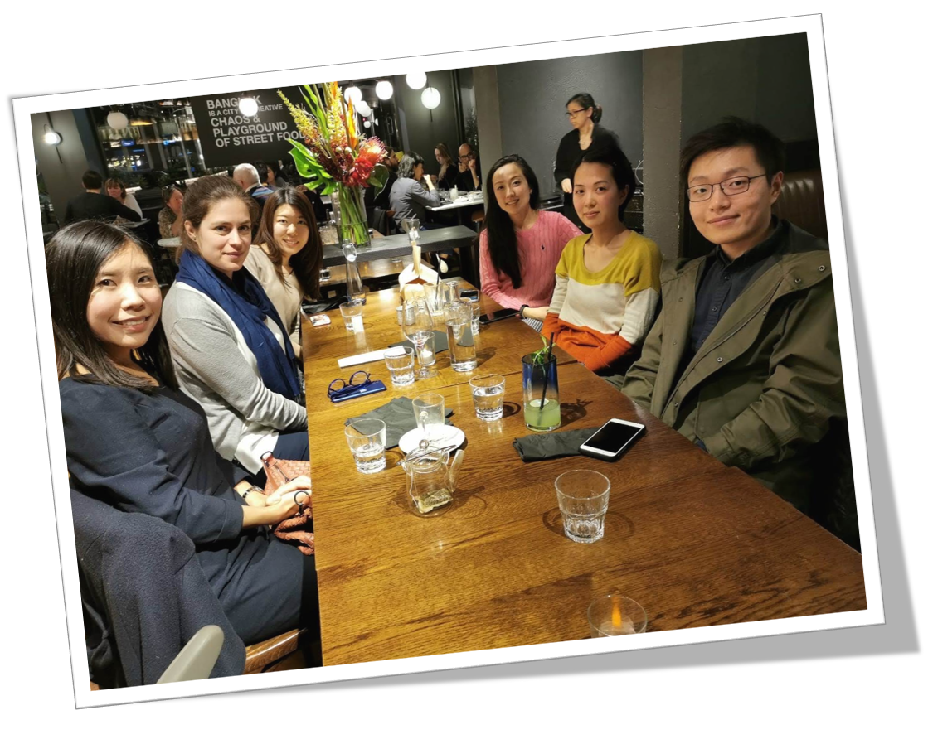
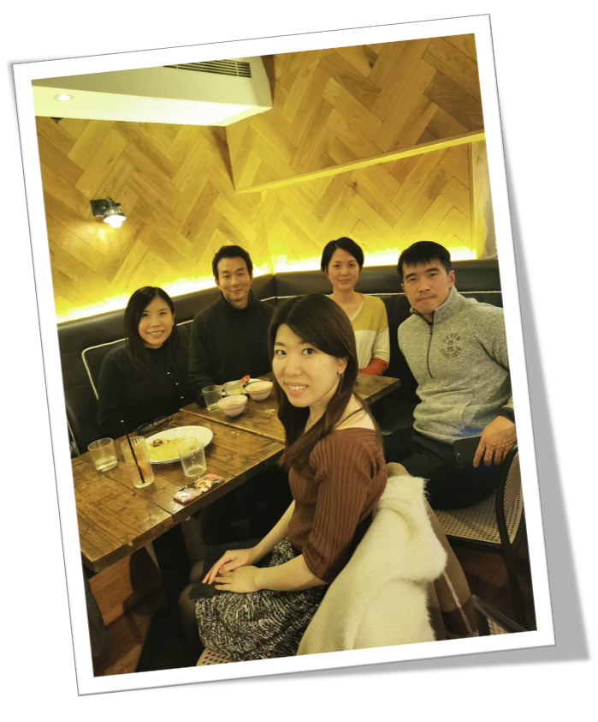
We are a nice team to work with!
Looking forward to working with you
Social Gatherings
Celebrating ExCo’s graduation

Slide 13
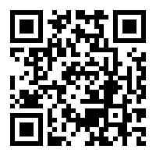
Q&A
Register on CampusGroup if you have not!

